Slide 1

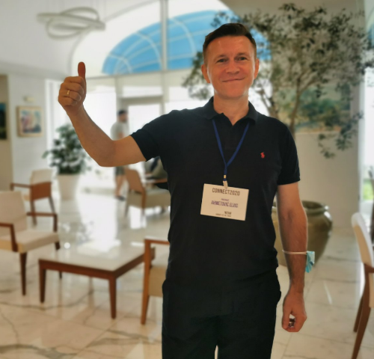




How to write a successful project proposal and get funds
Elvis Ahmetović elvis.ahmetovic@untz.ba

Slide 2
What is a successful project proposal?
A successful project proposal is one that is selected to be funded and gets money.

Slide 3
What should be your goal in writing project proposal?
To convice the funding source to give you money to realise your project idea and achieve the expected impact.

Slide 4

You should remember!
Unique idea
Hight impact
Excellence
Sustainability
Only the best project proposals get the money!

Slide 5
Important phases in a project from an idea to the end of the project
Phase 1
Project idea
Phase 2
Proposal writing
Phase 3
Proposal submission
Phase 4
Phase 5
Phase 6
Finding appropriate project call
Consortium building
Evaluation by External Experts
Grant agreement preparation & signature
Project start
Phase 7
Project end
Midterm reporting
Implementation
Final reporting
Big picture first, details later

Slide 6

An example of an unique expertise and idea
Partner 1
Partner 3
Partner 2

Slide 7


Large-scale network
Medium-scale network
Small network
Large-scale projects
Medium-scale projects
Small projects
Applicant(s)
Consortium
Different calls for project proposals
Eligibility criteria
Funding programmes/ organisation(s)
Guide for writing project proposals
Selection criteria and evaluation by experts
Only best proposals are funded
Unique and excellent idea, outstanding proposal
Evidence about knowledge, skills and expertise
Evidence about previous projects and results
Evidence about experience and collaboration networks
Evidence about published papers in high impact journas
Convince the funding organisation to give you funds/money!
EU funding programmes
Non-EU funding programmes
Funding Programmes in your country
Ministry of Education and Science
University
Industrial companies

Slide 8



























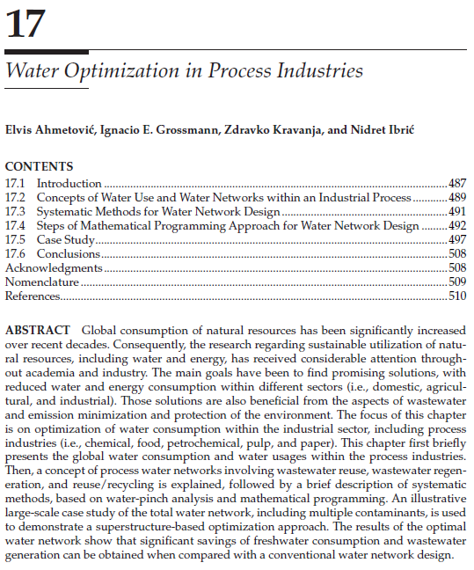




Evidence - Some of my achievements
International programmes
International collaboration
Resullts of research work on projects published in international journals
Books and book chapters
09/08/2021
8

Slide 9





TARGET
Activities

Slide 10

Start
Activities
Finish
Evidence of progress
Cost
Impact
Impact
Cost
The best value for money!
Time

Slide 11
Different projects
Industrial projects
Establish cooperation with industry
Solve specific problems
Mobility projects
Visit host institution
Get new knowledge
Bilateral projects
Establish bilateral cooperation
Exchange knowledge and experience
Economical and Environmental benefits
Improve process efficiency
Strenghten cooperation
Multilateral projects
Establish multilateral cooperation
Exchange knowledge and experience
Work on the same project
Get new skills and experience
Present home institution
Work on the same project
Strenghten cooperation and expand network

Slide 12














Evidence - My participation is several different projects
Industrial projects
Mobility projects
Multilateral projects
Bilateral projects

Slide 13
Philosophy for writing project proposal is generic
Applicable to all project proposals
Different programmes
Different subjects/topics
Different funding sources

Slide 14

Key questions about project proposal planning
Idea, action, event, thing
People/partners
Way, quantity, quality
Place
Time
Reason/Because

Slide 15
Relevance
Project Design & Implementation
Partnerships & Collaboration Arrangements
Impact, Dissemination & Sustainability
Project proposal

Slide 16




Relevance
Project Design & Implementation
Partnerships & Collaboration Arrangements
Impact, Dissemination & Sustainability
Carefully read User guide for applicants
Provide evidence for statements in your proposal
Project proposal
Provide all details about activiities in your proposal
Be consistent in different parts of proposal

Slide 17
Describe the general aims
and objectives
Explain how needs analysis
is performed and how you plan
to address to identified gaps
Explain what is an added value
Overall aims and
specific objectives
Needs analysis and
identified gaps in relevant
thematic area
Added value
Relevance
Project Design & Implementation
Partnerships & Collaboration Arrangements
Impact, Dissemination & Sustainability
Project proposal

Slide 18
Concept and methodology
Work plan
Work packages and activities
(objectives/expected outcomes, list
of activities, milestones/control
points, deliverables/project
outputs time/deadlines)
Timetable (Gantt chart)
Roles of partners in the project implementation
Finacial management and budget
Risk management (risks and risk-mitigation measures)
Relevance
Project Design & Implementation
Partnerships & Collaboration Arrangements
Impact, Dissemination & Sustainability
Project proposal

Slide 19
Relevance
Project Design & Implementation
Partnerships & Collaboration Arrangements
Impact, Dissemination & Sustainability
Project proposal
Consortium set-up
(rationale for the consortium
composition, expertise, strenghts and roles of partners,
cooperation arangements)
Consortium management and decision-making
(governing bodies, management
and communication tools)

Slide 20
Relevance
Project Design & Implementation
Partnerships & Collaboration Arrangements
Impact, Dissemination & Sustainability
Expected impact of the project at various levels (system, institutional, individual)
How impact will be reached and measured (KPI)
Communication, dissemination and visibility of funding
Sustainability and continuation
Project proposal

Slide 21

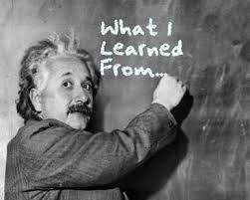

Relevance
Project Design & Implementation
Partnerships & Collaboration Arrangements
Impact, Dissemination & Sustainability
Unique idea and
consortium expertise
Needs Analysis Added value
Good balance between goals, work to be done, time, and budget
Instructions, Details, Evidence and Consistency
High impact
Sustainability
Acceptance rates are around 10-20%!
The best proposals
are only funded!
Project proposal

Slide 22
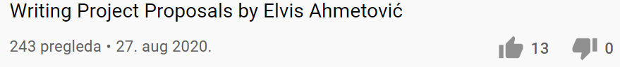
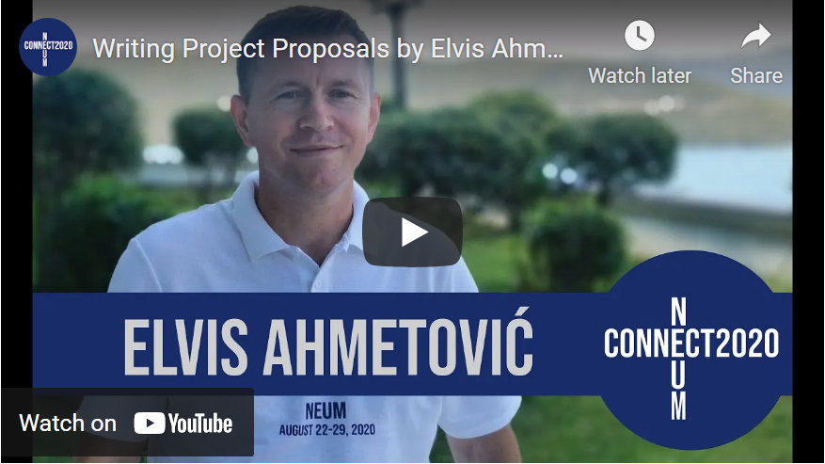
https://www.youtube.com/watch?v=4kMg6eYhc00

Slide 23
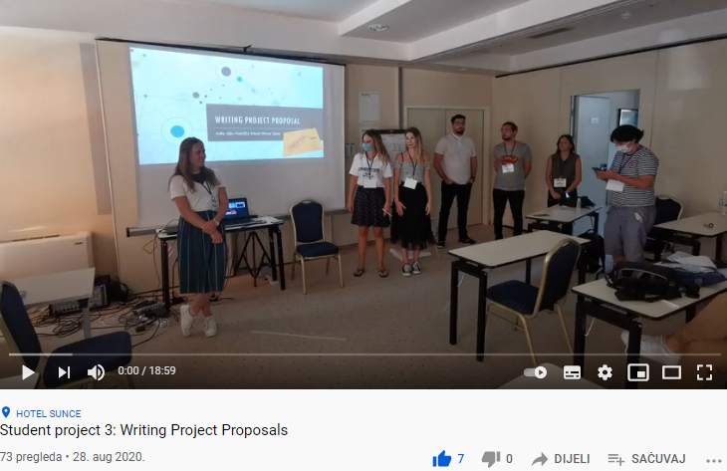
https://www.youtube.com/watch?v=GcouwLJBiwQ

Slide 24

https://interbaproject.com/

Slide 25


https://www.youtube.com/watch?v=rGOM2ZhP6PQ

Slide 26


Acknowledments
https://www.connect2020.online/

